Slide 1

Uncovering the Drivers Behind Rising Hotel Cancellation Rates: Data Analysis Project

Slide 2

Project Roadmap:
Define Problem Statement: Address the issue of increasing cancellation orders in hotels.
Data Identification: Select the dataset hotels.csv for analysis.
Data Preparation: Clean and explore the data using Python to ensure quality and consistency.
Data Analysis: Extract insights to identify reasons behind the rise in hotel cancellation orders.

Slide 3

Introduction:
This project aims to identify the key factors contributing to the increasing rate of hotel booking cancellations. We will explore primary reasons, such as high average daily rates, and secondary factors, including discrepancies between online hotel photos and actual conditions. Utilizing the Python programming language, we will begin with data cleaning, manipulation, and normalization using the Pandas library to handle outliers and null values. Following this, we will employ data visualization tools like Matplotlib and Seaborn to create insightful plots. Through detailed analysis of these visualizations, we will uncover the underlying reasons for the surge in hotel cancellation orders.

Slide 4
Tools I Used:
1. Kaggle: Source of the hotels dataset.
2. Python Programming Language: Used for overall data manipulation and analysis.
3. Pandas Library: Utilized for data cleaning, manipulation, standardization (normalization), and handling outliers and null values.
4. Matplotlib: Employed for data visualization.
5. Git & GitHub: for sharing my analysis and insights.

Slide 5
Data Inspection:
4.1. Import Important Libraries and Modules:
import pandas as pd
import matplotlib.pyplot as plt
import datetime as dt
import warnings
warnings.filterwarnings('ignore')
4.2. Export Target Dataframe:
df = pd.read_csv('D:\\Dataset\\hotels.csv')

Slide 6

Data Cleaning and Formatting:
1. Dealing With Nan Values:
Drop Columns ('agent', 'company').
Drop Nan Values Of Columns ('country', 'children').
2. Type Casting of Column (reservation_status_date) to Datetime.
3. Data Normalization and Standardization.
Data Normalization of Column (meal).
Data Normalization of Column (country).
Data Normalization of Column ('is_canceled').
4. Dealing With Ouliers In Column 'adr' Average Daily Rate
Dealing With Outliers In Column "adr" Average Daily Rate

Slide 7
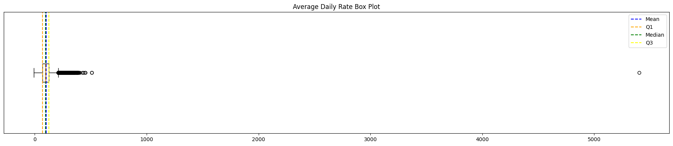
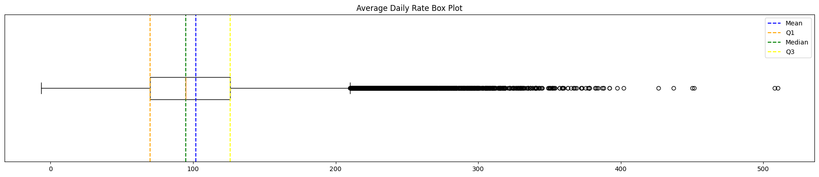
Average Daily Rate Column Box Plot Visualization to Clearly Show the Variability of the "adr" Column Values Before Dealing with Outliers:
Average Daily Rate Column Box Plot Visualization to Clearly Show the Variability of the "adr" Column Values After Dealing with Outliers:

Slide 8


Exploratory Data Analysis (EDA)

Slide 9
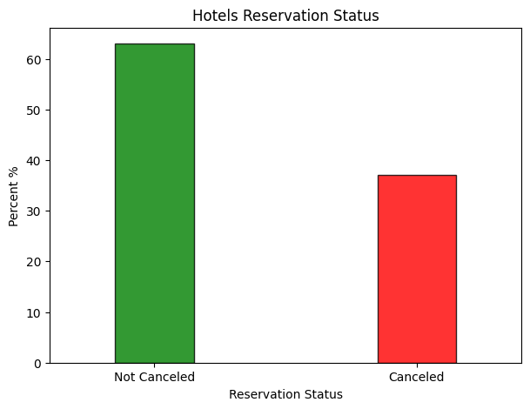
(1) Hotels Reservation Status Analysis:
Key Insights:
A significant insight from this plot is that a majority of the reservations are not canceled, indicating that most customers follow through with their hotel bookings.
However, there is still a notable proportion of cancellations, which suggests potential areas for improvement in understanding customer needs or addressing issues that lead to cancellations.

Slide 10
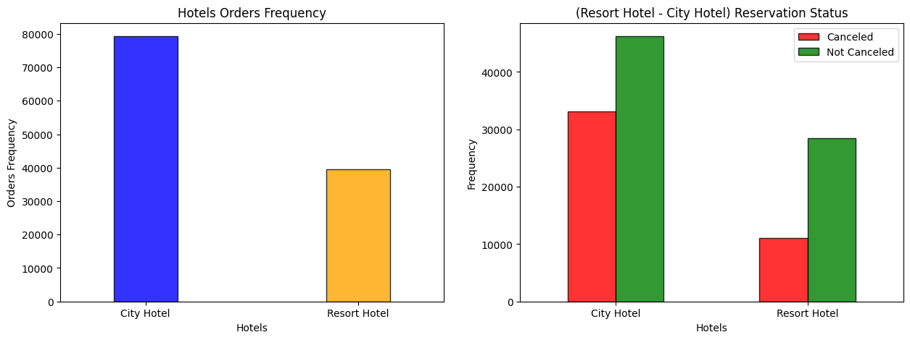
(2) Comparison of Reservation Statuses Between City and Resort Hotels:
Key Insights:
City hotel experience a higher volume of both cancellations and completed stays compared to resort hotels.
On the other hand, resort hotels, while having fewer overall bookings, show a relatively lower frequency of cancellations compared to city hotel.

Slide 11
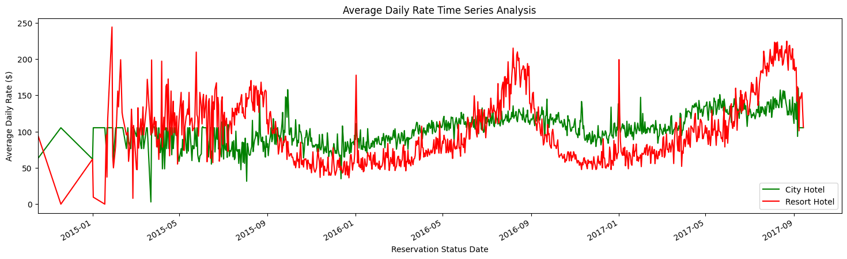
(3) Time Series Analysis of Average Daily Rates for City and Resort Hotels:
Key Insights:
Resort hotels exhibit significant volatility in their average daily rates, with pronounced peaks that could correspond to seasonal demand or special events, suggesting a more dynamic pricing strategy. In contrast, city hotels maintain relatively more stable rates with fewer fluctuations.

Slide 12
(4) Monthly Trends in Hotels Booking Cancellation Rate:
Key Insights:
January and July exhibit the highest cancellation rates, suggesting potential issues such as post-holiday fatigue or dissatisfaction with holiday bookings.
August shows the highest number of non-canceled bookings, indicating a peak travel period where customer satisfaction or commitment to travel plans is at its highest.

Slide 13
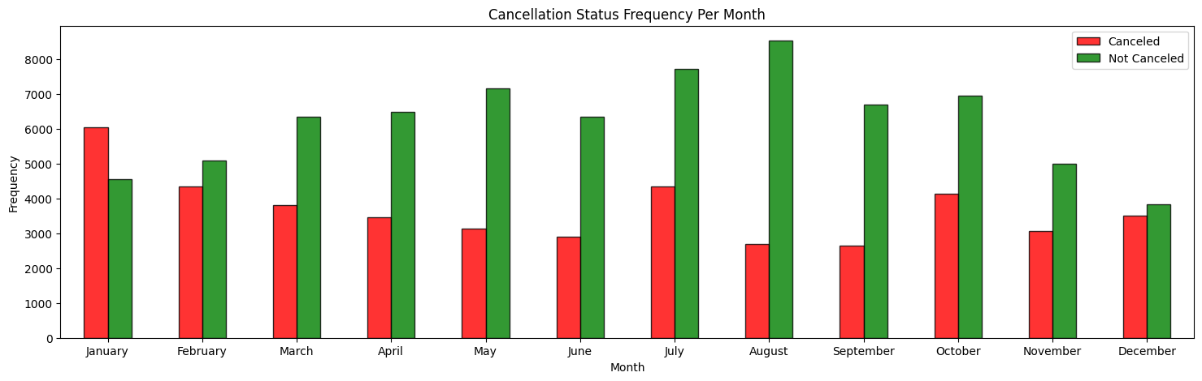
The insights suggest a need for targeted strategies to reduce cancellations during peak cancellation months, potentially through improved customer engagement or more accurate service representation.

Slide 14
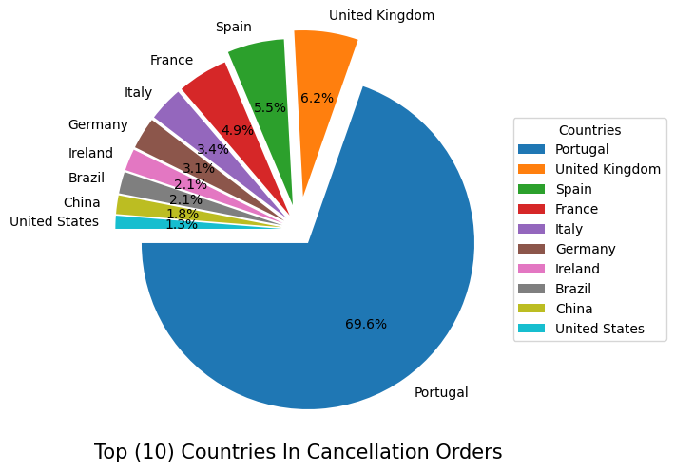
(5) Distribution of Cancellation Orders Across Top 10 Countries in the Dataset:
Key Insights:
Portugal accounts for nearly 70% of the total cancellations. This suggests potential issues specific to the Portuguese market, such as economic factors, customer dissatisfaction, or targeted marketing strategies that may not align with customer expectations.
The United Kingdom and Spain also show notable cancellation rates, indicating regional trends that may require further investigation.
The relatively lower cancellation rates from countries like the United States and China suggest more stable booking behaviors or higher satisfaction rates. These insights point to the need for localized strategies to address the high cancellation rates in key markets like Portugal, the United Kingdom, and Spain.

Slide 15
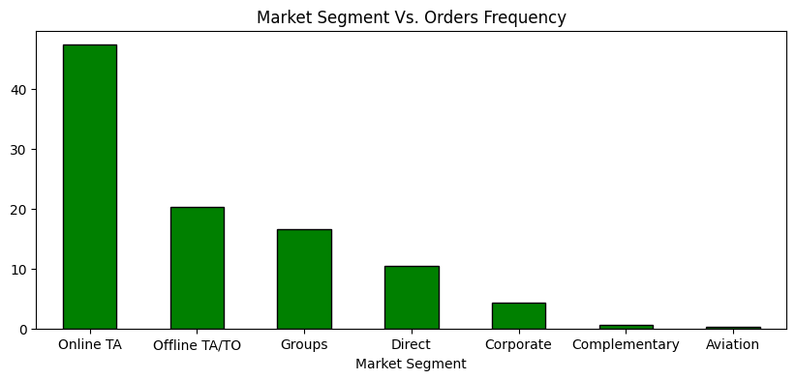
(6) Analysis of Hotel Booking Order Frequencies Across Different Market Segments:
Key Insights:
The bar chart reveals that the Online TA (Travel Agency) marketing segment dominates hotel bookings by a significant margin, indicating a strong consumer preference for online platforms when reserving hotel accommodations.
The Offline TA/TO (Traditional Travel Agencies/Tour Operators) and Groups segments also contribute notably to the booking frequency, though to a lesser extent, highlighting the continued relevance of traditional booking methods and group travel.
The relatively low frequency of bookings in the Direct, Corporate, Complementary, and "Aviation" segments suggests either limited engagement for these categories.

Slide 16
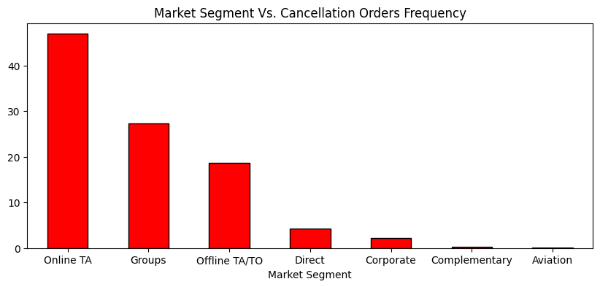
(7) Analysis of Hotel Booking Cancellation Frequencies Across Different Market Segments
Key Insights:
The chart shows that most hotel booking cancellations happen through Online TA (Travel Agency), suggesting that people might be having second thoughts and discrepancies between online hotel photos and actual conditions or facing issues with online bookings.
The Groups segment also has a lot of cancellations, which might be due to changes in plans or difficulties in organizing group trips.

Slide 17
(8) Trends of Average Daily Rates for Canceled and Non-Canceled Hotel Orders Over Time for Resort and City Hotels:
Key Insights:
Notably, there are periods where canceled orders (in red) tend to have higher average daily rates compared to non-canceled orders (in green), suggesting that price sensitivity might be a contributing factor to cancellations.
Reservations are canceled when the average daily rate is higher than when it is not canceled, so it means the higher prices of the average daily rate lead to a higher level of cancellation.

Slide 18
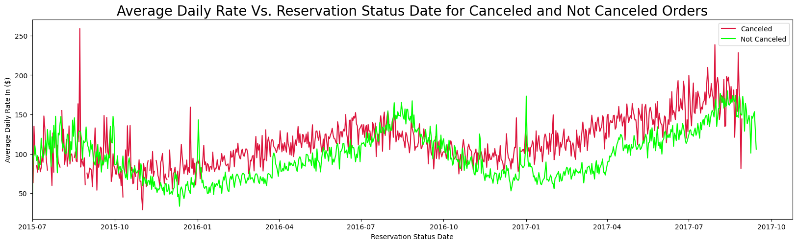
Peaks in the average daily rates for canceled orders could indicate that customers are more likely to cancel reservations when prices are higher, possibly due to finding better deals elsewhere or reconsidering the value of their booking.

Slide 19
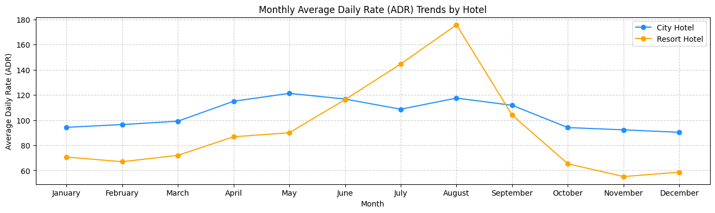
(9) Seasonal Variations in Average Daily Rates for City and Resort Hotels
Key Insights:
Resort Hotels experience a significant surge in Average Daily Rates (ADR) during the summer months, particularly in July, August, and September. In contrast, City Hotel exhibits more stable ADR throughout the year, with only slight increases during March, April, and May.

Slide 20

Recommendations

Slide 21
Investigate and address the root causes of cancellations, particularly in high-cancellation months like January and July. Improve post-holiday experiences and ensure holiday bookings meet customer expectations.
Benefit from the peak travel period in August by ensuring high customer satisfaction and commitment. For Resort Hotels, prepare for increased demand during the summer months with competitive pricing and enhanced service offerings.
Focus on understanding and addressing the unique needs of the Portuguese market, which accounts for a significant portion of cancellations. Create marketing strategies to better align with customer expectations in Portugal, the United Kingdom, and Spain.
Since the majority of cancellations occur through Online Travel Agencies (OTAs), ensure that online booking platforms provide an accurate and realistic description of hotel conditions. Enhance the user experience to minimize discrepancies between expectations and reality.
Improve pricing strategies, particularly during peak periods. High average daily rates correlate with increased cancellations, so consider dynamic pricing models that balance profitability with customer retention.

